Slide 1
Database Management System
I am your instructor for DBMS
Narendra Gupta
Software Development @ SASS my own firm
Primarily Involved in development of web based Management Information System (MIS)
Those include Cement Industry ERP, Hospitals, Colleges, NGO/INGO/Govt. Projects….
That’s all about me…………………….

Slide 2
Text Books
Database System Concepts
A. Silberschatz, H.F. Korth, and S. Sudarshan,
Fundamental of Database Systems (4th/6th Edition) Ramez Elmasri and Shamkant B. Navathe

Slide 3
Course Synopsis
First database course for Bsc CSIT
Basically this course will introduce you to the fundamentals of database technology
You will learn
The concepts and methods required for designing the database systems
And use these concepts practically in developing commercial database management systems.

Slide 4
What do we learn today?
Introduction
Characteristics of database approach
Advantages of using DBMS

Slide 5
Introduction
Database has become an essential component of life in modern days
Eg. Airplane reservation, bank deposit or withdraw, purchase book online,etc..
All these activities involve some interaction with the database
In general, Database is a collection of related data. It can be generated & maintained manually or it may be computerised.

Slide 6
Introduction contd…
A database management system (DBMS) is a collection of programs that enables users to create and maintain a database.
DBMS includes the following steps:
Defining (specifying data types,structure,constraints.)
Constructing (process of storing the data on storage medium)
Manipulating(querying the database to retrieve specific data , updating the database to reflect changes)
Sharing ( multiple users & programs access data simultaneously)

Slide 7
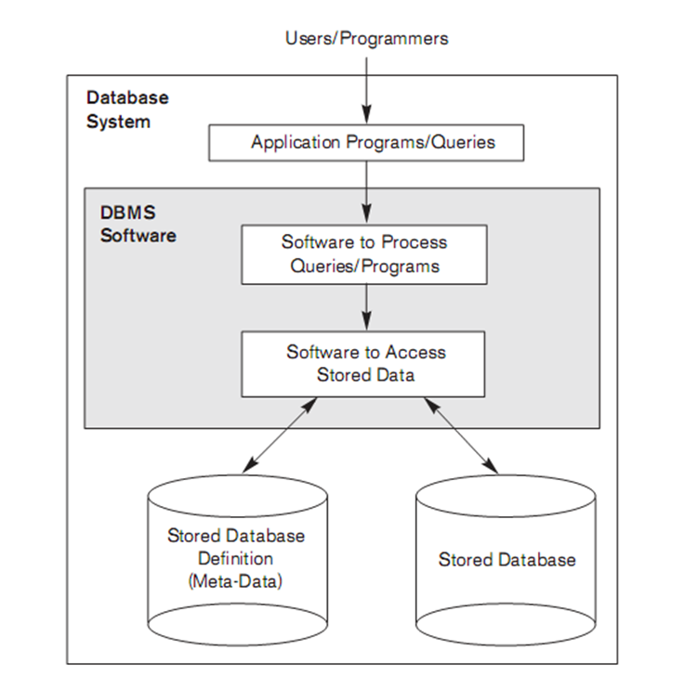
Database system environment

Slide 8
Characteristic of Database Approach
Database Approach Vs Traditional File Processing
In traditional file processing, each user maintains separate files of record.
They have to maintain a separate copy of record
i.e redundant effort in maintaining the record
In database approach, a single repository maintains data that is defined once and then accessed by various users

Slide 9
Characteristics contd…
Self-Describing Nature of a Database System
a complete definition or description of the database structure and constraints is stored in a catalog called meta-data.
DBMS software package is not written for a specific database

Slide 10
Characteristics contd..
Support of Multiple Views of the Data
A database typically has many users, each of whom may require a different perspective or view of the database. A view may be a subset of the database or it may contain virtual data that is derived from the database files but is not explicitly stored

Slide 11
Sharing of Data and Multiuser Transaction Processing
A fundamental role of multiuser DBMS software is to ensure that concurrent transactions operate correctly and efficiently
The DBMS must include concurrency control software to ensure that several users trying to update the same data do so in a controlled manner so that the result of the updates is correct

Slide 12
Advantages of dbms
Controlling Redundancy
Restricting Unauthorized Access
Providing Storage Structures and Search techniques for Efficient Query Processing
Providing Backup and Recovery
Providing Multiple User Interfaces
Representing Complex Relationships among Data

Slide 13
Advantages contd..
Enforcing Integrity Constraints

